Slide 1
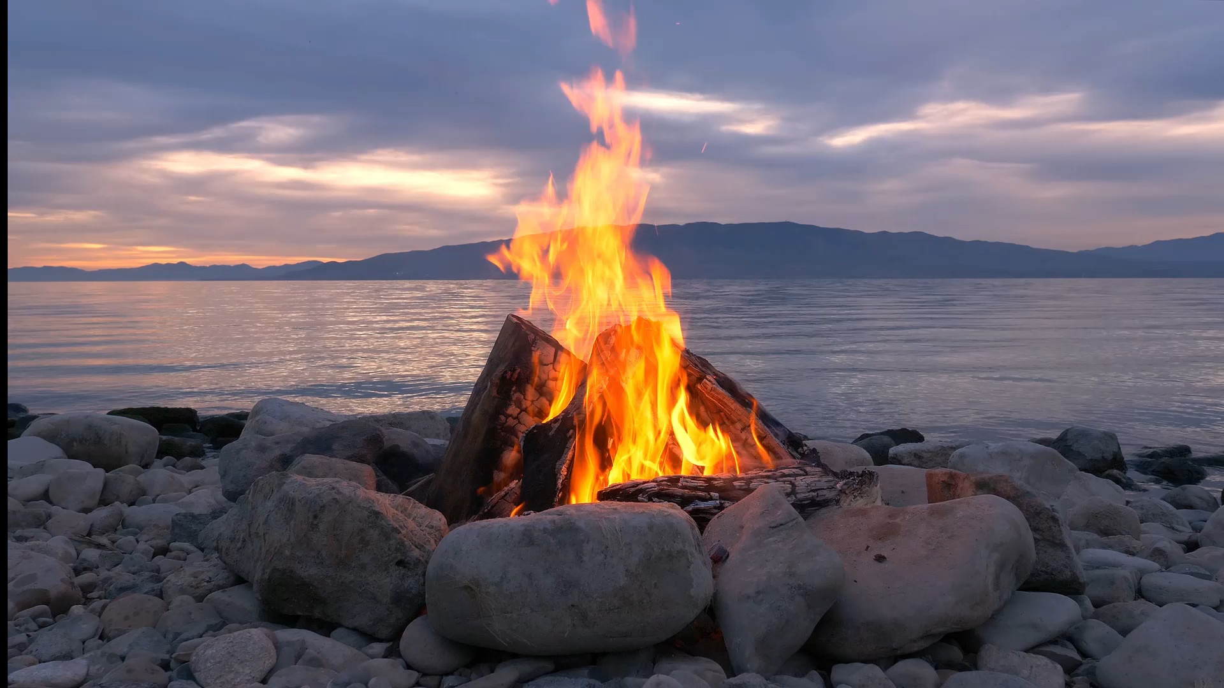
Wildfire Data Analysis

Slide 2
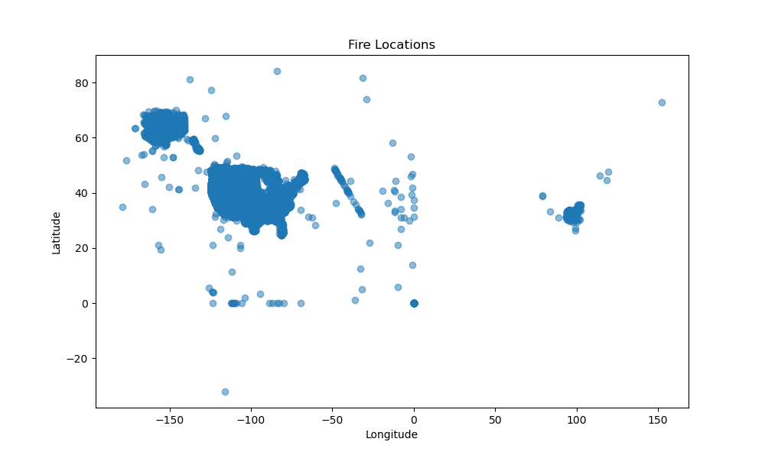
Scatter plot of fire locations based on longitude and latitude

Slide 3
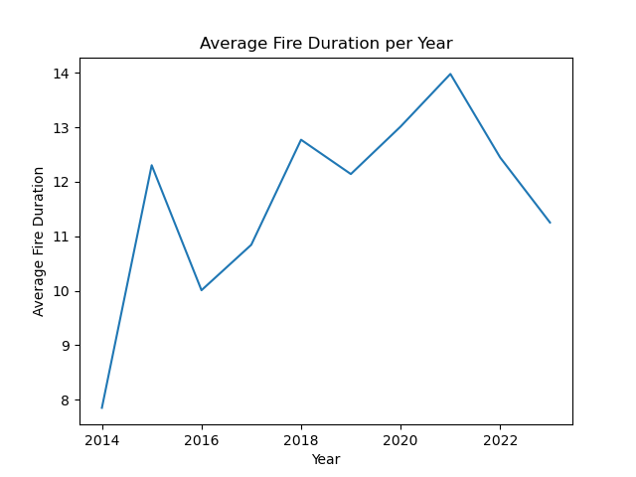
Line graph for Average fire duration per year in days

Slide 4
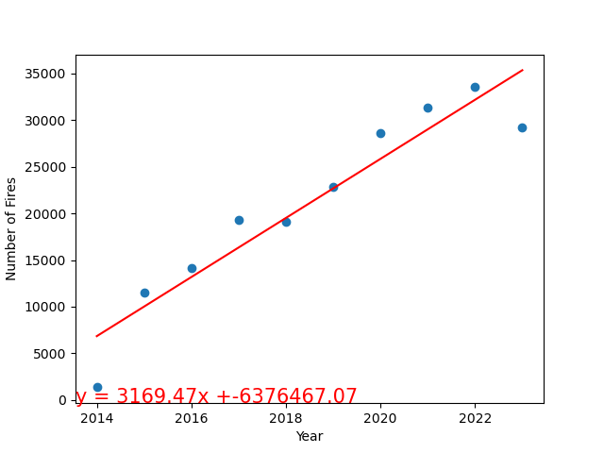
Linear Regression on fires per year

Slide 5
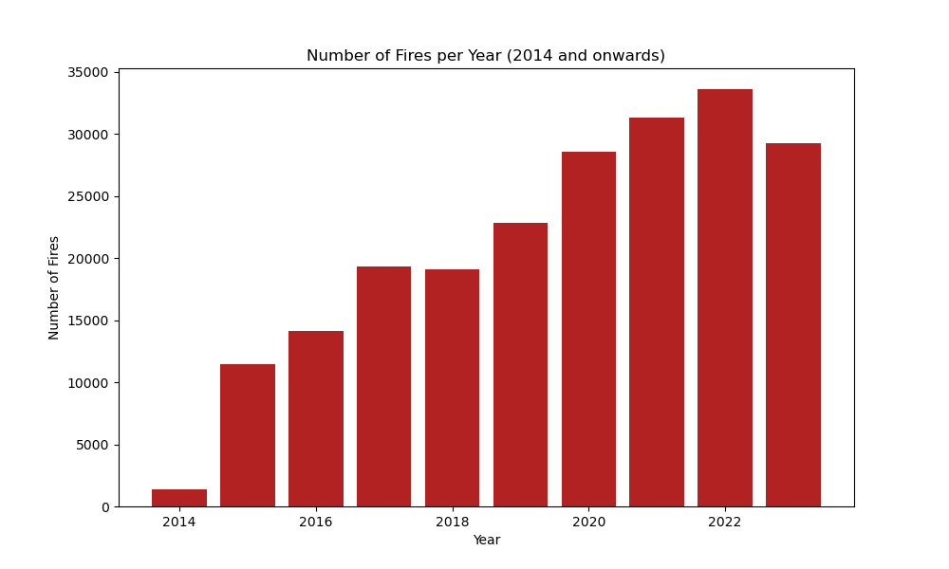
Bar graph of number of fires per year

Slide 6
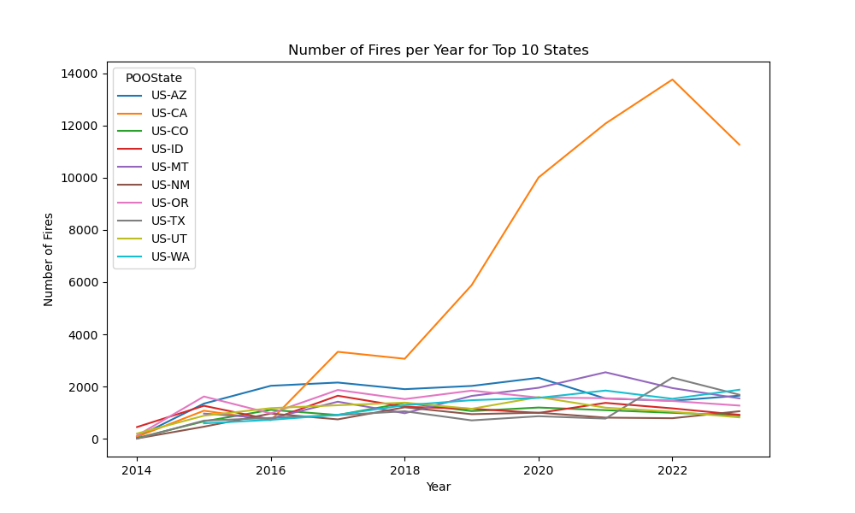
Line graph for number of fires in the top 10 states

Slide 7
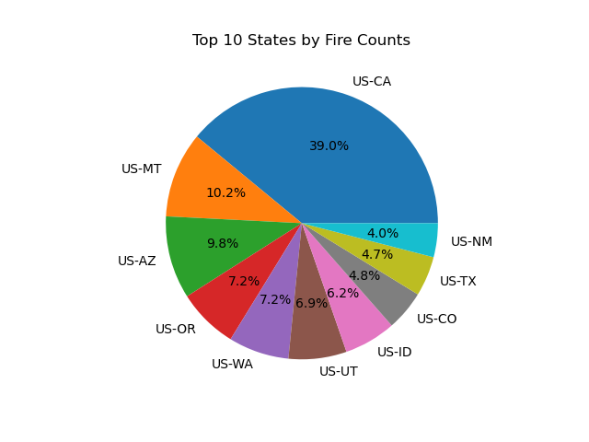
Top counties grouped by state pie graph

Slide 8
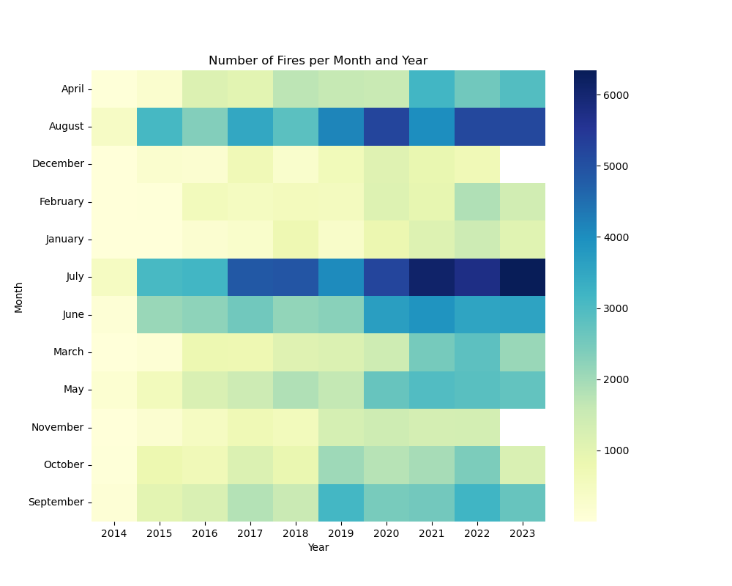
Heat map of number of fires per month

Slide 9
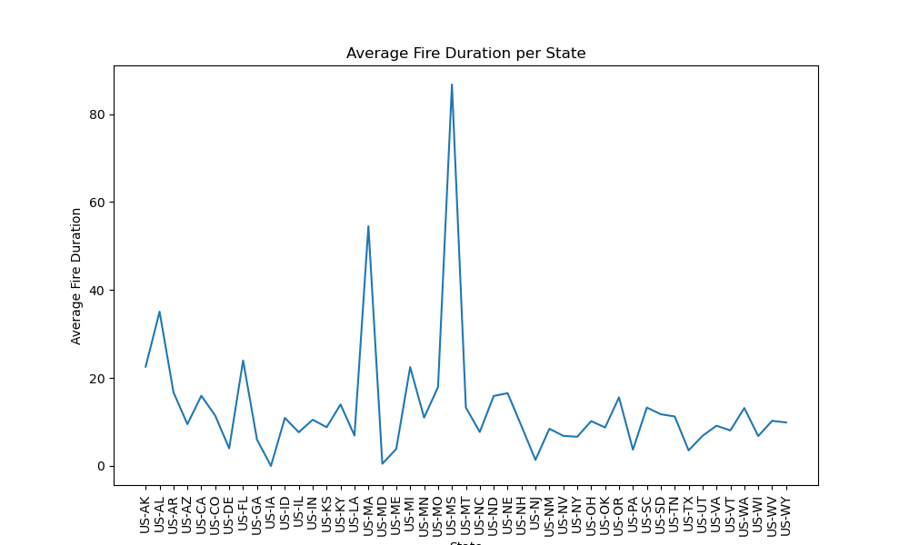
AVERAGE FIRE DURATION PER STATE

